Slide 1
Lending Club Case Study
Program: EPGP in AI-ML Aug 2024, IIIT- Bengaluru
Contributors:
Santoshkumar Vagga
Neeraj Kumar

Slide 2
Problem statement
Goals of data analysis:
Lending loans to ‘risky’ applicants is the largest source of financial loss (called credit loss). The credit loss is the amount of money lost by the lender when the borrower refusesto pay or runs away with the money owed.
The main objective is to be able to identify these risky loan applicants, then such loans can be reduced thereby cutting down the amount of credit loss. Identification of such applicants using EDA is the aim of this case study.
Perform an analysis to understand the driving factors (or driver variables) behind loan default, i.e.the variables which are strong indicators of default. The company can utilise this knowledge for its portfolio and risk assessment.

Slide 3
Analysis Approach
Given a dataset (loan.csv) and data dictionary for it.
We found lot of unwanted columns with single value, null vaues, so we removed them from the dataset.
We are doing analysis for loans which are already marked as charged off or fully paid to identify the patterns, so we vomited the on-going loan status.
We found outliers, type casted variables, standardized values, handled missing values.
Once the dataset is ready for analysis, we did univariate, bi-variate analysis with different combinations of Target variable(loan status) and other variables in dataset.

Slide 4
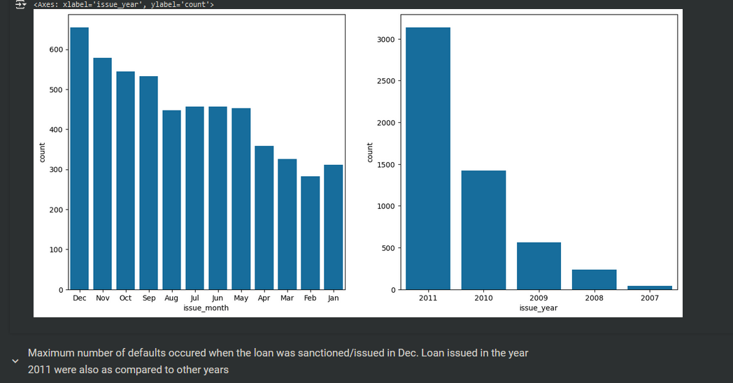
Analysis visualisations

Slide 5
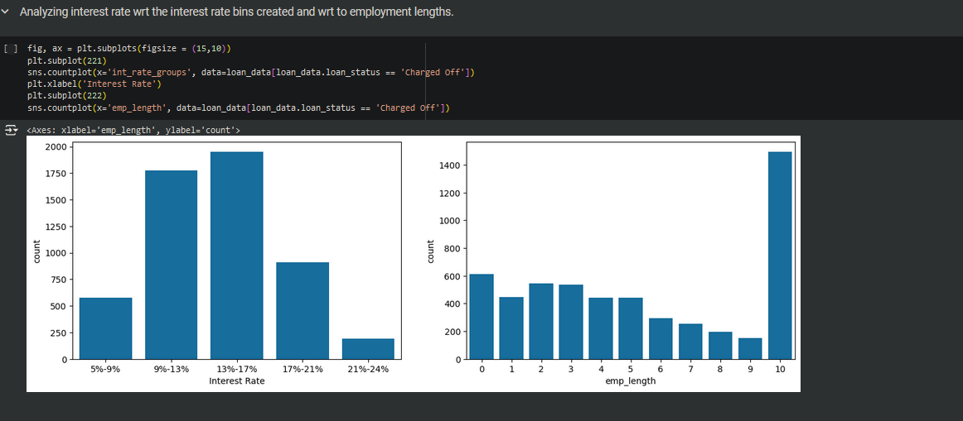
Analysis visualisations

Slide 6
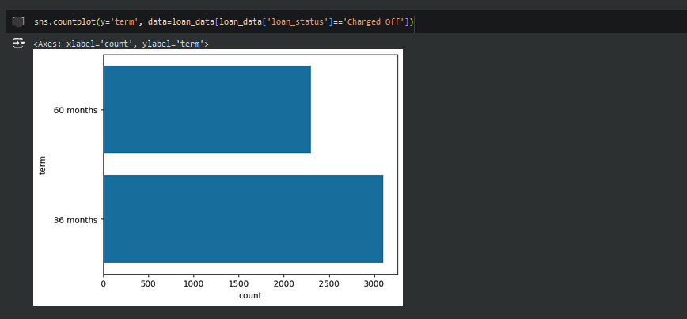
Analysis visualisations

Slide 7
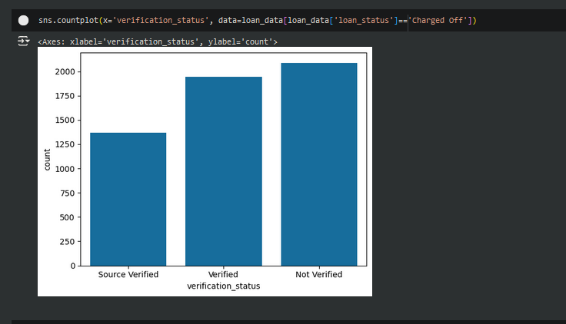
Analysis visualisations

Slide 8
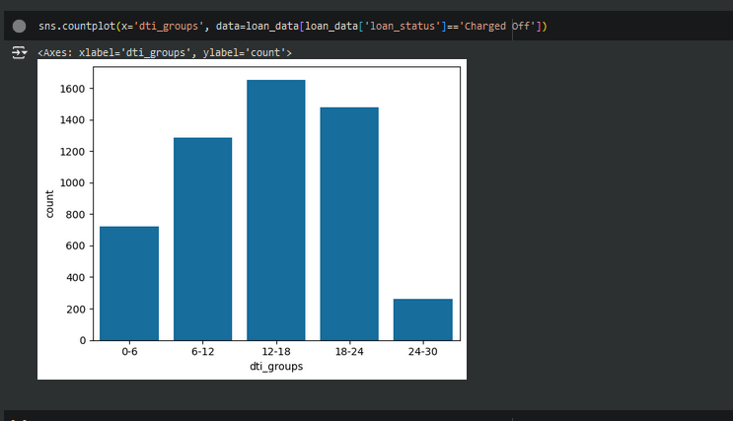
Analysing outcomes

Slide 9
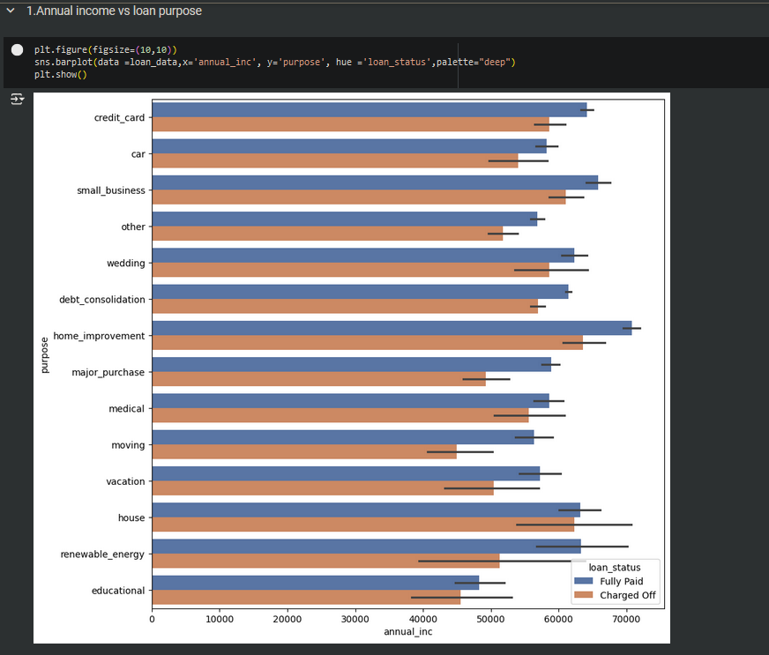
Analysis visualisations

Slide 10
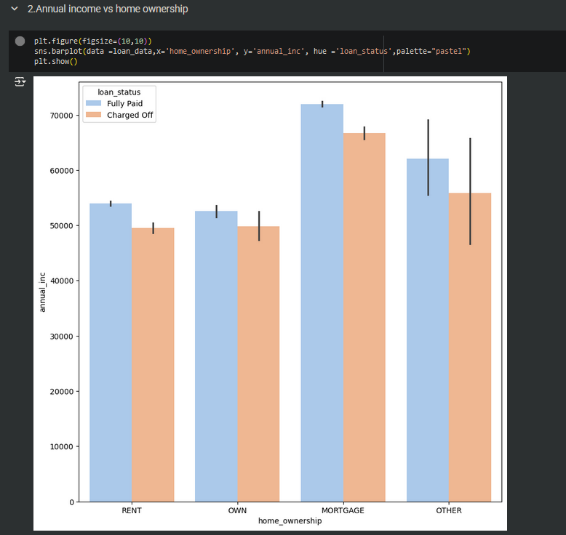
Analysis visualisations

Slide 11
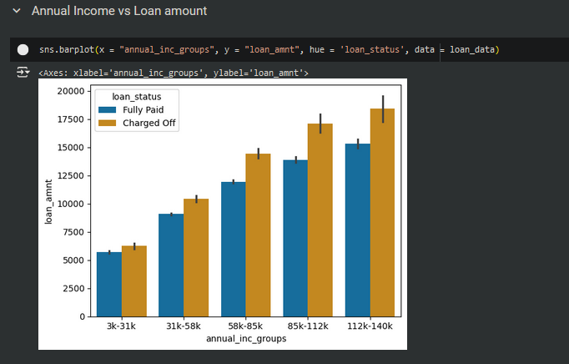
Analysis visualisations

Slide 12
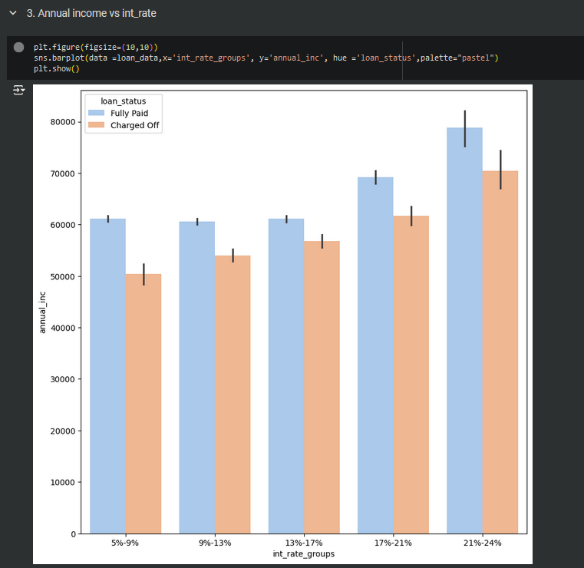
Analysis visualisations

Slide 13
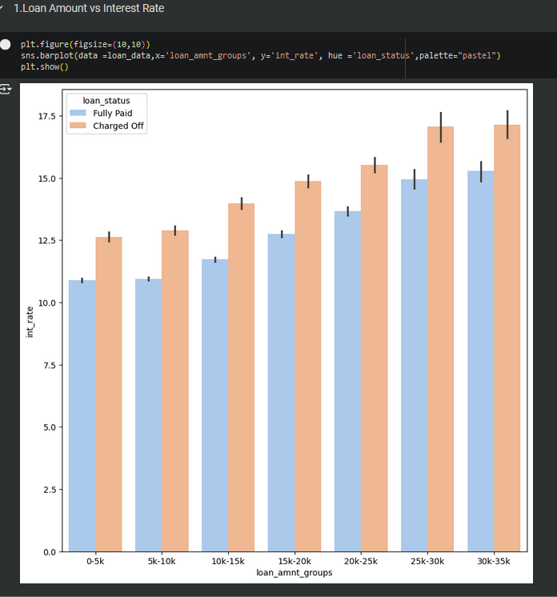
Analysis visualisations

Slide 14
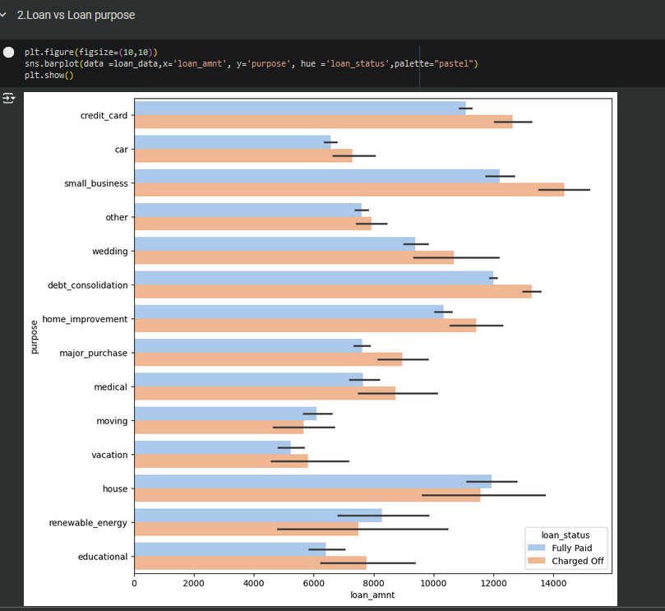
Analysis visualisations

Slide 15
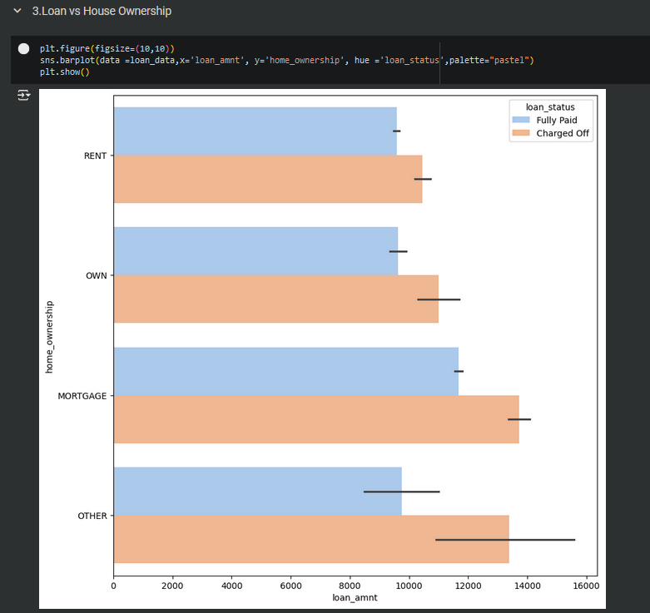
Analysis visualisations

Slide 16
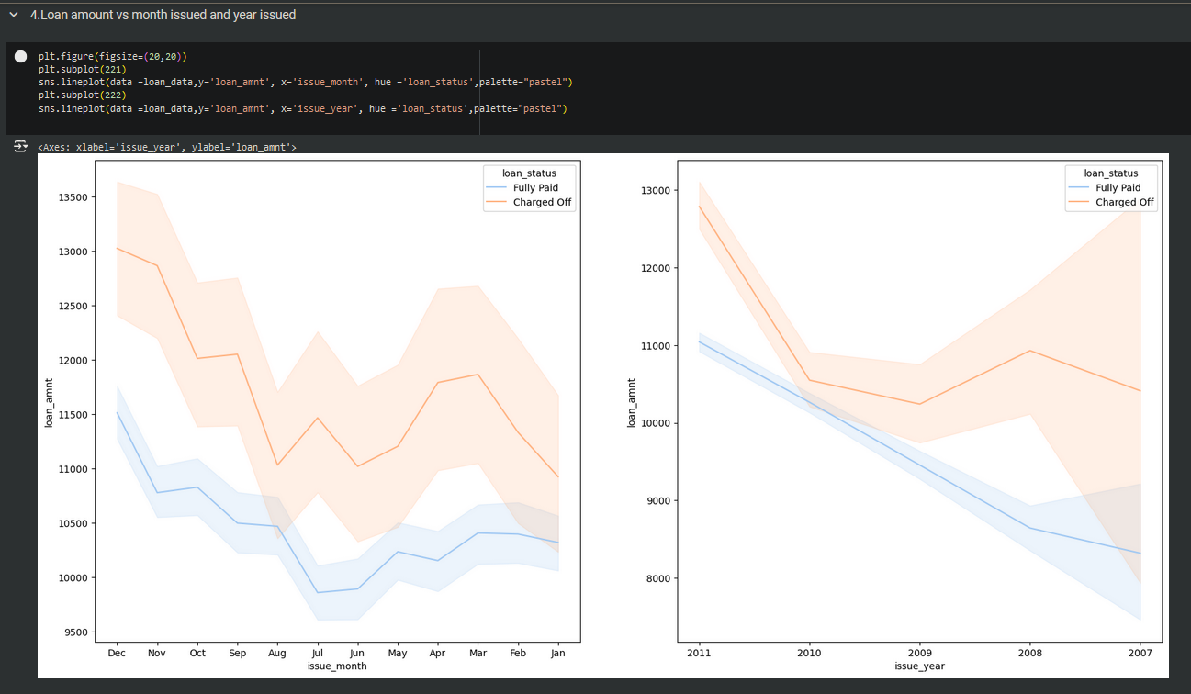
Analysis visualisations

Slide 17
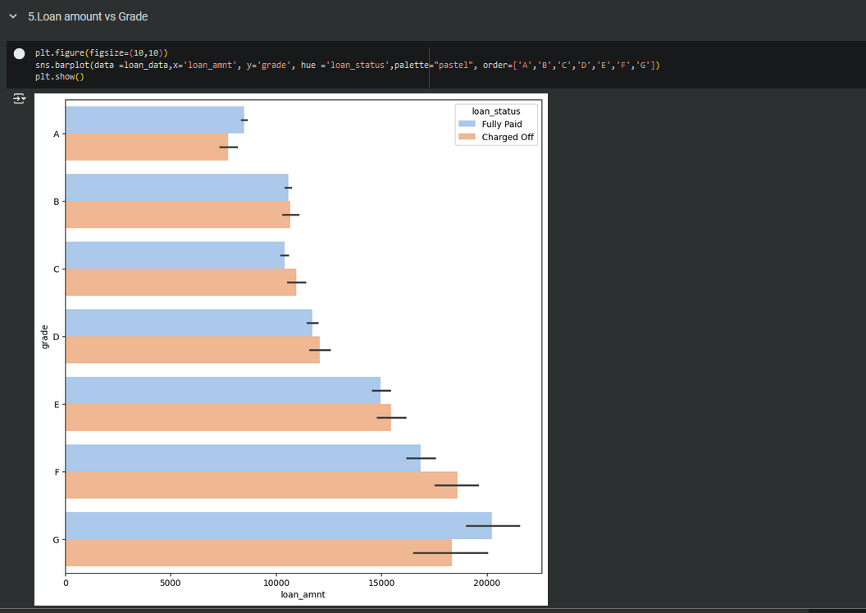
Analysis visualisations

Slide 18
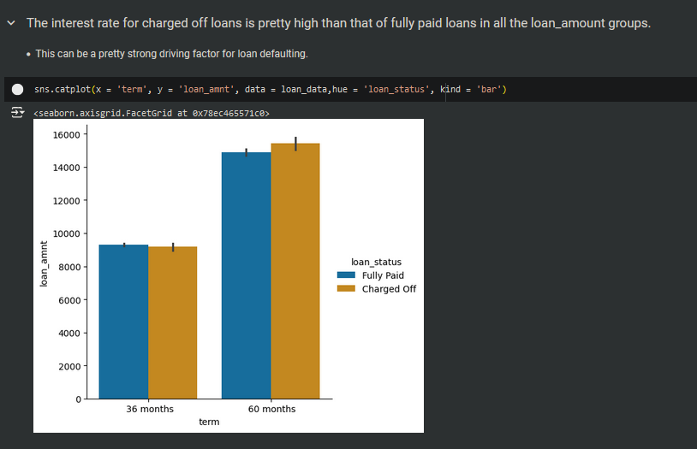
Analysis visualisations

Slide 19
Observations-1
The above analysis with respect to the charged off loans for each variable suggests the following. There is a more probability of defaulting when :
Applicants having house_ownership as 'RENT'
Applicants who use the loan to clear other debts
Applicants who receive interest at the rate of 13-17%
Applicants who have an income of range 31201 - 58402
Applicants who have 20-37 open_acc
Applicants with employement length of 10
When funded amount by investor is between 5000-10000
Loan amount is between 5429 - 10357
Dti is between 12-18
When monthly installments are between 145-274
Term of 36 months
When the loan status is Not verified
When the no of enquiries in last 6 months is 0
When the number of derogatory public records is 0
When the purpose is 'debt_consolidation'
Grade is 'B'
And a total grade of 'B5' level.

Slide 20
Observations-2
The above analysis with respect to the charged off loans. There is a more probability of defaulting when :
Applicants taking loan for 'home improvement' and have income of 60k -70k
Applicants whose home ownership is 'MORTGAGE and have income of 60-70k
Applicants who receive interest at the rate of 21-24% and have an income of 70k-80k
Applicants who have taken a loan in the range 30k - 35k and are charged interest rate of 15-17.5 %
Applicants who have taken a loan for small business and the loan amount is greater than 14k
Applicants whose home ownership is 'MORTGAGE and have loan of 14-16k
When grade is F and loan amount is between 15k-20k
When employment length is 10yrs and loan amount is 12k-14k
When the loan is verified and loan amount is above 16k
For grade G and interest rate above 20%

Slide 21
Recommendations for Lending Club agency for better profitability via minimum credit loss
1. Screening House Ownership:
- Avoid high-risk applicants with house ownership status marked as 'RENT' or 'MORTGAGE' (especially when income is within the 60k-80k range), as these applicants have shown a higher likelihood of default.
2. Loan Purpose & Debt Consolidation:
- Prioritize applicants with loan purposes other than debt consolidation, home improvement, or small business loans, as these purposes are associated with higher default rates.
3. Interest Rate Caps:
- Set a maximum interest rate cap below 13%, as applicants charged rates in the 13-24% range are more prone to defaulting.

Slide 22
Recommendations for Lending Club agency for better profitability via minimum credit loss
4. Income Range Filters:
- Avoid applicants with an income range of 31,201 - 58,402 and 60k-80k, especially when paired with loans for home improvement or other non-essential uses, as these income brackets appear at higher risk.
5. Loan Amount Control:
- Be cautious with applicants seeking loans between $5,429 - $10,357 or $15k - $35k, particularly those with a DTI ratio between 12-18 and monthly installments in the range of 145 - 274.
6. Employment Length Verification:
- Ensure that applicants' employment length is verified and consider lengthier employment as a factor. 10 years of employment is a critical cutoff point, with higher risk associated with longer durations.

Slide 23
Recommendations for Lending Club agency for better profitability via minimum credit loss
7. Credit Enquiries and Records:
- Avoid applicants with 0 inquiries in the last 6 months and no derogatory public records—counterintuitively, this indicates a higher likelihood of defaulting. Verified records and inquiries are essential.
8. Loan Term Limit:
- Prefer shorter loan terms. Defaults are more common in 36-month terms.
9. Lower Grade Applicants:
- Be more cautious with applicants in Grade B, B5, F, and G. Defaults increase when loans are issued to these grades, especially with high loan amounts or interest rates exceeding 20% for Grade G applicants.

